Slide 1
Welcome to my website !!!
I like to take photo whenever i go where these are my pictures that i had traveled
~~

Slide 2
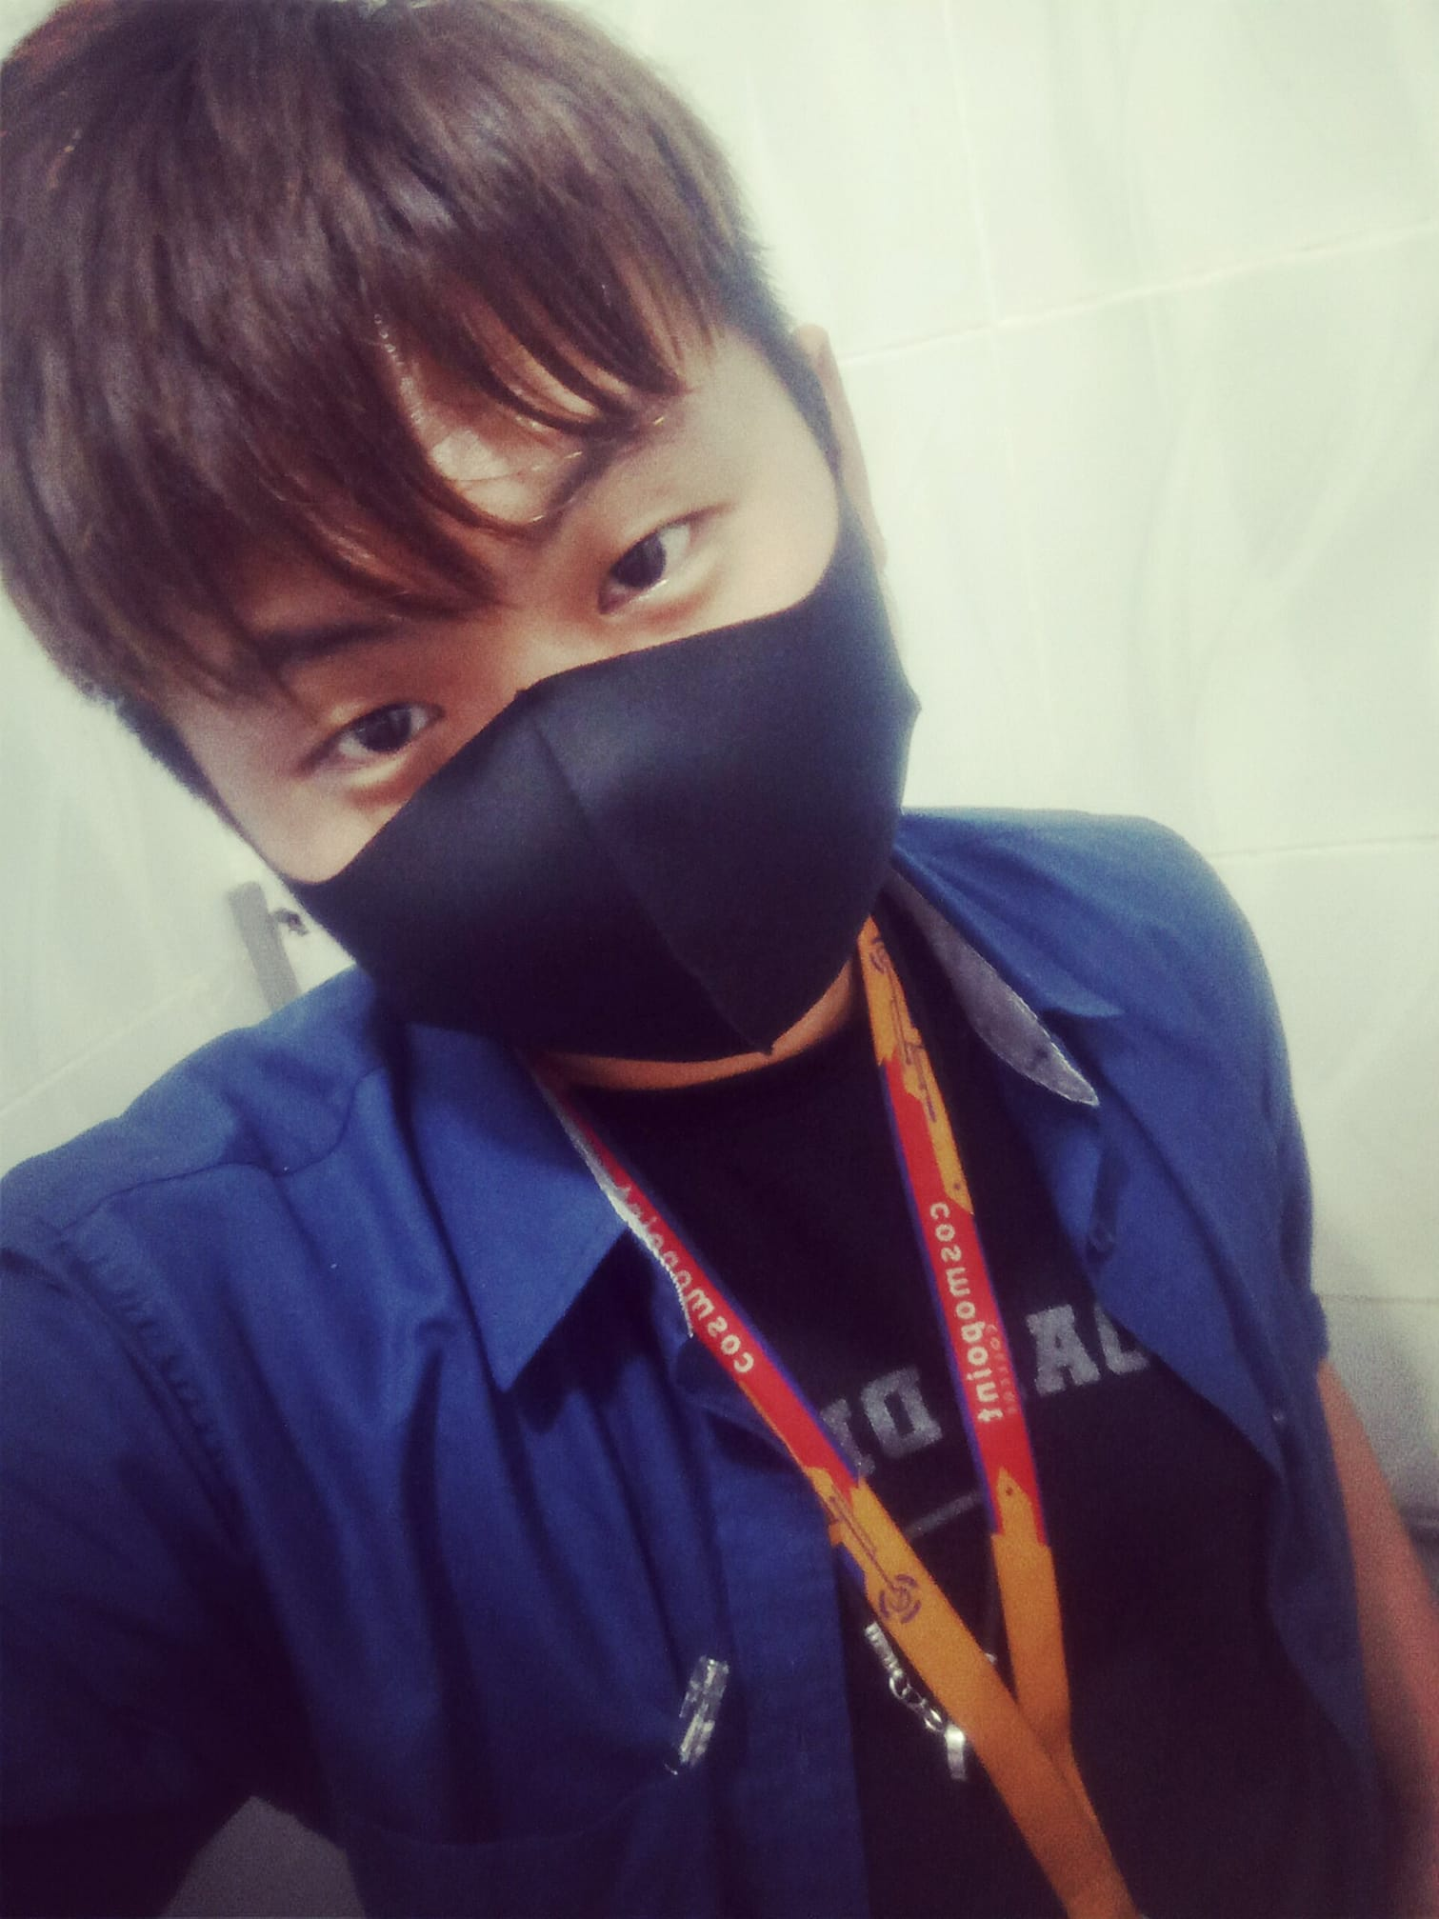
My name is Albert jeffery,I would like to share about myself . I’m student Cosmopoint Colleges at Kota Kinabalu.

Slide 3
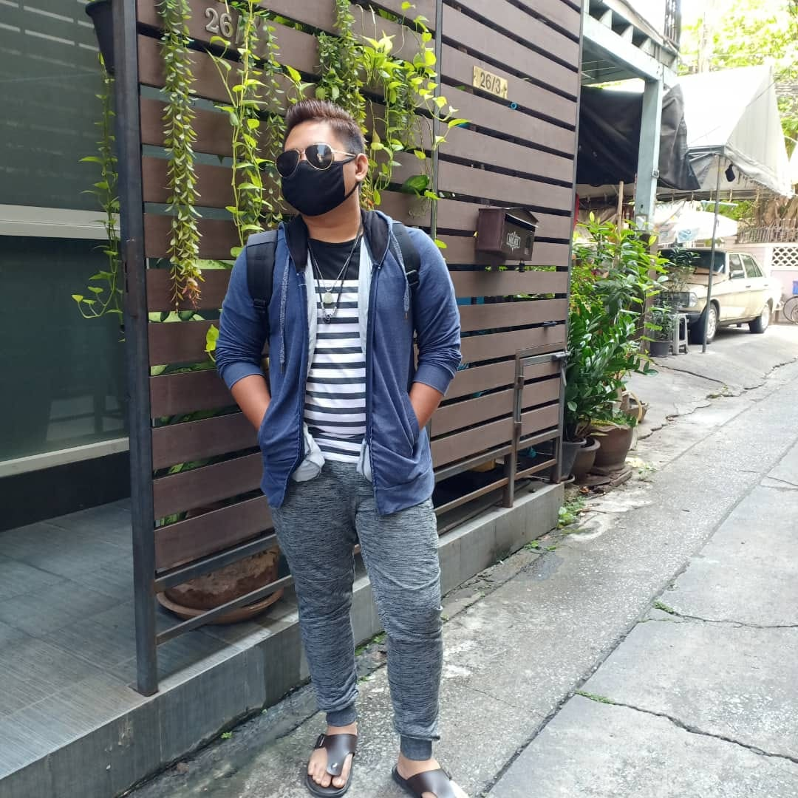
This photo that i took is from Thailand, Bangkok

Slide 4
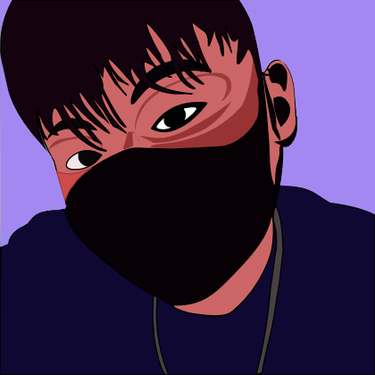
This is my sketch using Adobe Illustrater

Slide 5
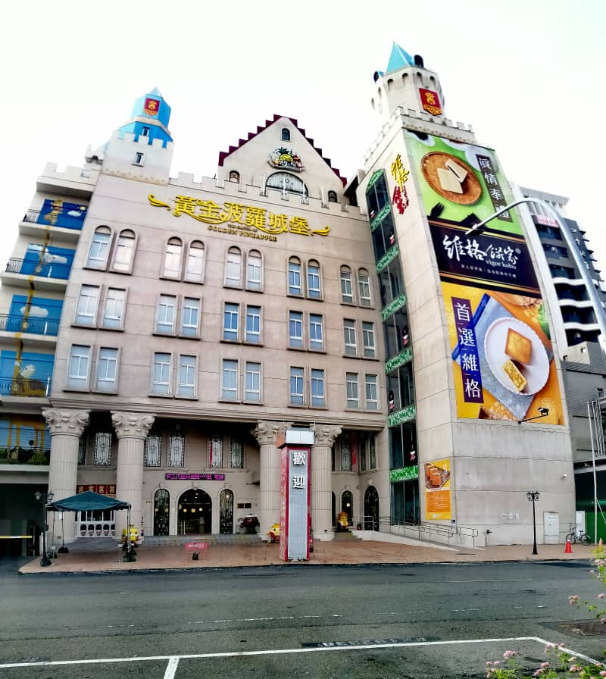

Slide 6
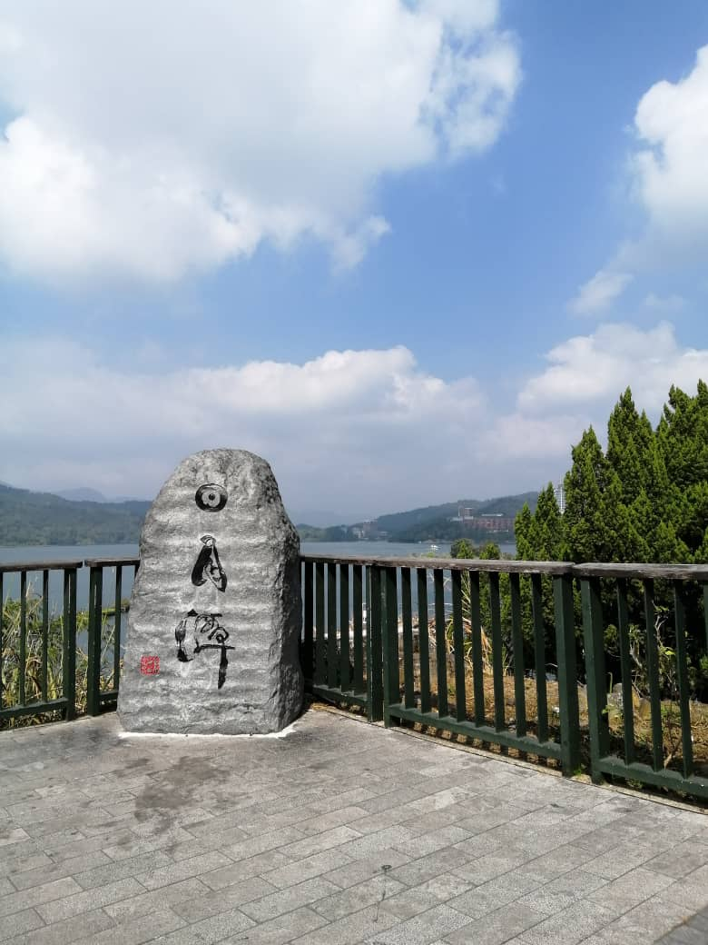

Slide 7
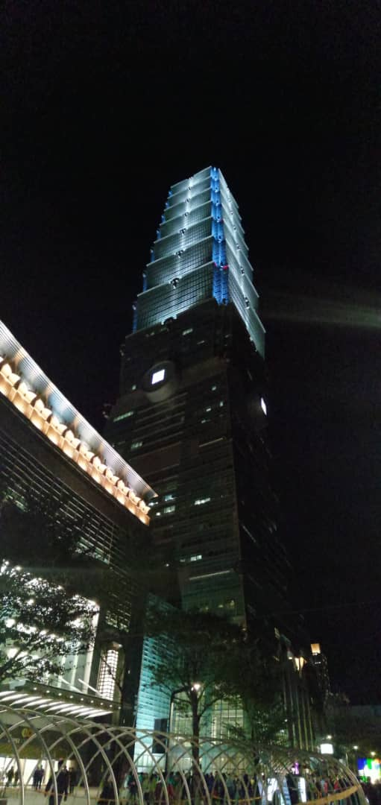

Slide 8
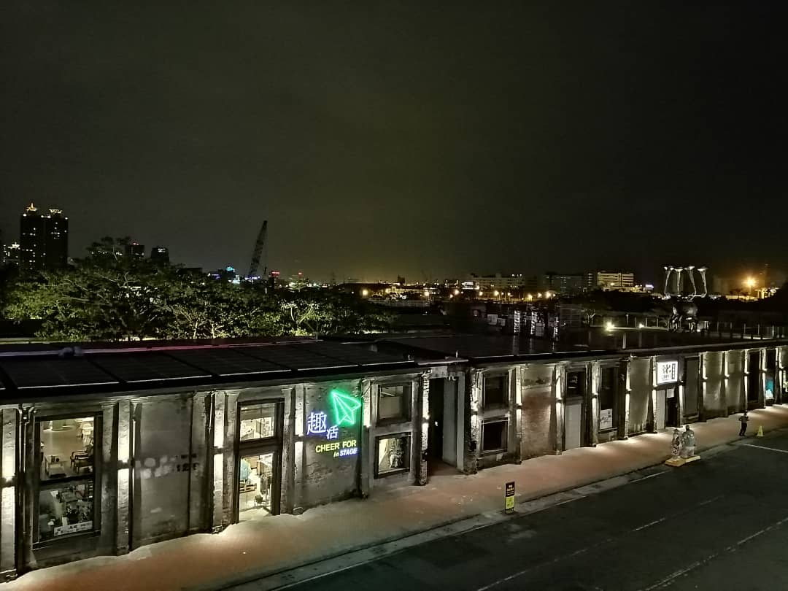

Slide 9
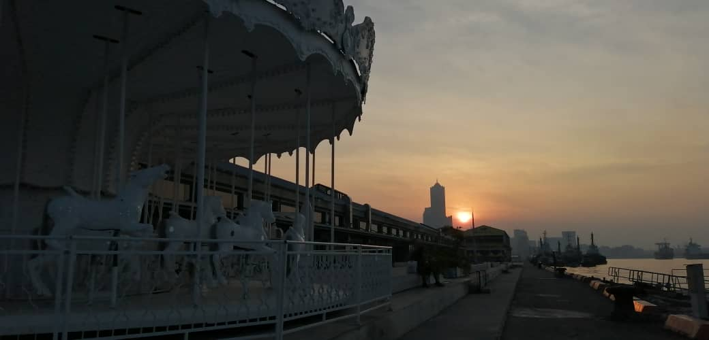

Slide 10
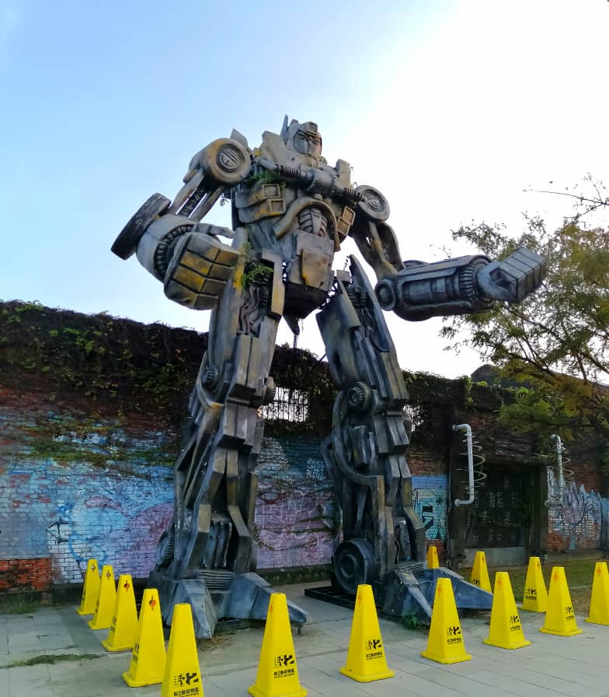

Slide 11
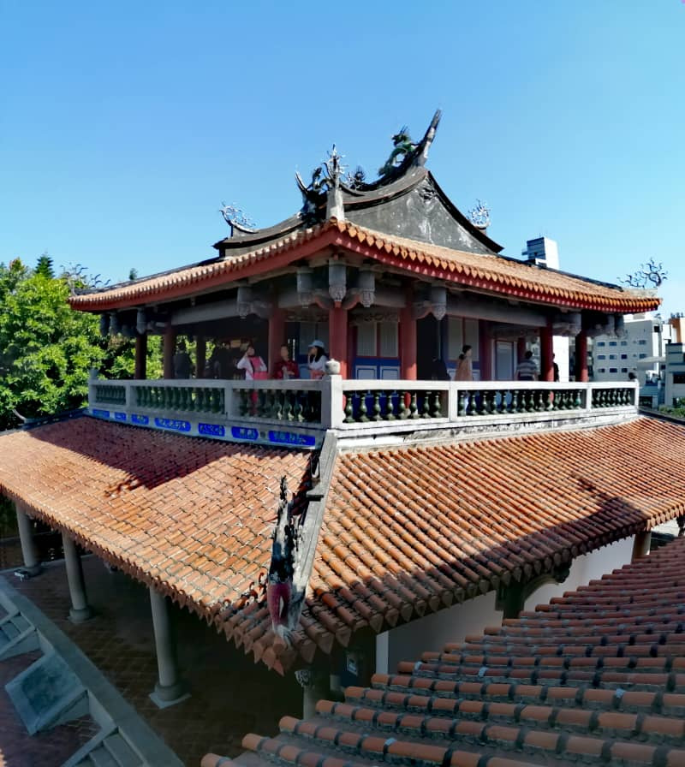

Slide 12
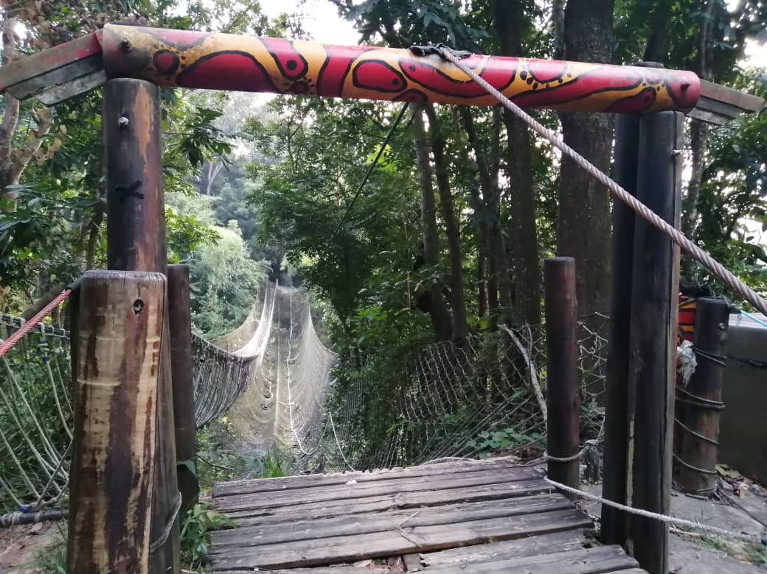

Slide 13
